Slide 1
Formative Assessment #3
Topics:
GLMs and quantile regression. Discussion based on Lecture 4.
PSQF 6270: FA #3

Slide 2
Q1
Are there any topics that you'd like to review more in class?
PSQF 6270: FA #3

Slide 3
Q1 Notes
Interactions (x3)
Recode and collapse variables
Zero-inflated vs. hurdle models
Over-dispersion vs under-dispersion
Interpretation of model results in real examples
Gamma distribution and logit link-function
Poisson Conditional Distribution
FA/Discussion in class about models (and slide 20 from lecture 4)
PSQF 6270: FA #3

Slide 4
Q2
Describe how generalized models with logit/probit links and binomial-family distributions can be used to predict accuracy (i.e., percent correct). What concerns should we be aware of when using a conditional binomial distribution?
PSQF 6270: FA #3

Slide 5
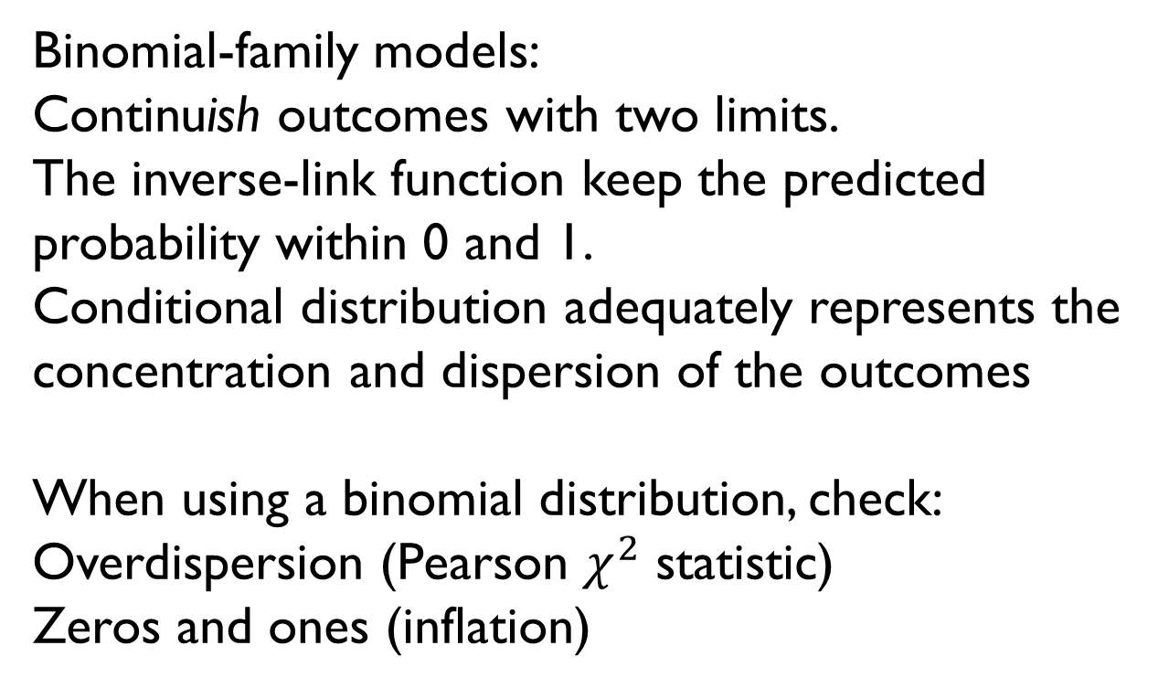
Q2 Notes (Slides 5–8)
Binomial-family models:
Continuish outcomes with two limits.
The inverse-link function keep the predicted probability within 0 and 1.
Conditional distribution adequately represents the concentration and dispersion of the outcomes
When using a binomial distribution, check:
Overdispersion (Pearson $χ^{2}$ statistic)
Zeros and ones (inflation)
PSQF 6270: FA #3

Slide 6
Q3
For what kind of outcomes and in what situations might quantile regression be used? Please give an example of a research question that it could answer.
PSQF 6270: FA #3

Slide 7
Q3 Notes (Slides 17–19)
Situation:
Outliers can affect the usefulness of the predicted mean of our continuish outcome.
The focus is on a particular part of the outcome distribution.
We can predict any percentile (e.g., conditional median) of the outcome and use resampling methods to obtain correct SEs for the FEs.
RQ:
Does the relationship between the number of hours slept and academic achievement vary between students with a low and a high GPA (e.g., 25th percentile vs 75th or 90th percentile)?
PSQF 6270: FA #3

Slide 8
Q4
In general, how would you know: (a) whether you need a link function to predict an outcome in a regression model, and (b) whether it should be in the logit/probit family or the log family?
PSQF 6270: FA #3

Slide 9
Q4 Notes
The outcome has limits that does not align with the predictions of the general linear regression.
Considering the limits of the observed outcome.
PSQF 6270: FA #3

Slide 10
Q5
How do the generalized linear models we've seen so far address or not address the following assumptions of typical "linear regression" (i.e., general linear models) about model residuals: independence, normality, and constant variance?
PSQF 6270: FA #3

Slide 11
Q5 Notes
Independence = we continue to assume that the residuals are independent of each other.
Normality and Homoscedasticity = the conditional distribution will dictate the shape of the distribution of the residuals and the variance function.
PSQF 6270: FA #3

Slide 12
Formative Assessment #3
Topics:
GLMs and quantile regression. Discussion based on Lecture 4.
PSQF 6270: FA #3

