Slide 1
Formative Assessment #2
Topics:
Binary and ordinal outcomes. Discussion based on Lecture 2.
PSQF 6270: FA #2

Slide 2
Q1: What problems would be created by predicting a binary or ordinal outcome using a standard general linear model?
Based on slides 7–10:
Mismatch between the outcome scale (categories) and the linear predictor.
Violation of model assumptions: the residuals do not have a normal distribution (across predictor values) nor is their variance constant (across predicted values).
PSQF 6270: FA #2
Notes:
Nonconstant variance translates to incorrect SEs.
Out-of-bounds predictions.
GLM "assumes" linear relationships != GLMs (and all models, in fact) assume whatever type of relationship you specified is correct.

Slide 3
Q2: What do you say to reviewer 3 who insists that you need to fit a probit regression instead of a logistic regression?
Based on slide 17:
Models have different scales, but they lead to the same conclusion.
Claude (v. 3.7 Sonnet) recommends:
“Thank you for your thoughtful suggestion. Probit and logistic regressions often yield similar results in practice. I chose the logistic because…”
PSQF 6270: FA #2
Notes:
In logistic regression we have odds ratios and integration is not needed to go to probs.
We could fit a probit model and compare its conclusions to those from the logistic model.

Slide 4
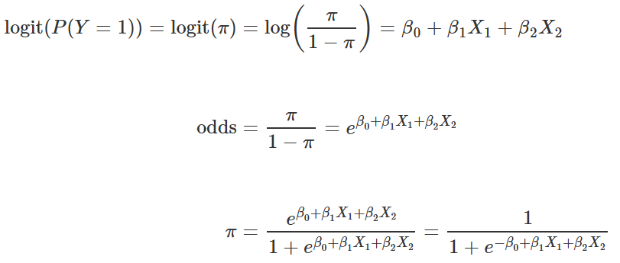
Q3: In trying to predict a binary outcome, how do the outcome scales of logit, odds, and probability relate to each other?
Based on slide 12:
logit = 0 ↔ odds = 1 ↔probability = .5
PSQF 6270: FA #2
Notes:
Predicted outcomes can be expressed in all three scales, but slopes cannot be expressed in terms of change in probability.

Slide 5
Q4.1: Describe how a cumulative logit or probit link function works for ordinal outcomes.
Based on slides 30–34:
The role of the link functions remains the same: to transform the conditional mean of the outcome.
Categorical outcomes need binary submodels to be predicted.
Cumulative link functions create binary submodels that divide lower vs higher categories.
PSQF 6270: FA #2
Notes:
Difference in link functions for ordinal data.
What choices are allowed (basically, cumulative for nominal is the only one that would be wrong).

Slide 6
Q4.2: How does a cumulative link function for ordinal outcomes differ from the link function used for nominal outcomes?
Based on slide 36:
The format of the binary submodels is different: all lower vs higher categories under cumulative link function, or two categories per submodel under baseline category link function.
PSQF 6270: FA #2

Slide 7
Formative Assessment #2
Topics:
Binary and ordinal outcomes. Discussion based on Lecture 2.
PSQF 6270: FA #2

